Slide 1
Extraction Transformation Loading Process
DWDM Lab #3

Slide 2
Extract – Extract data from source .csv files
Transform – Use filter , router and expressions transformtions , sorter and rank transformations
Load – Load the resultant data into target files

Slide 3
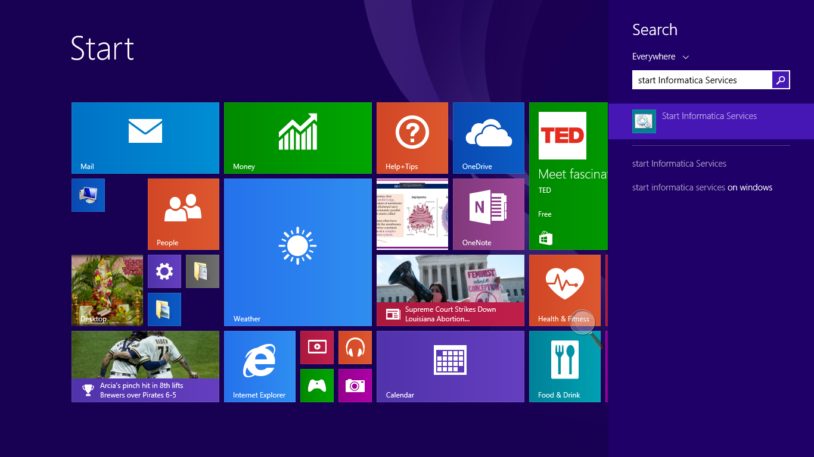

Slide 4
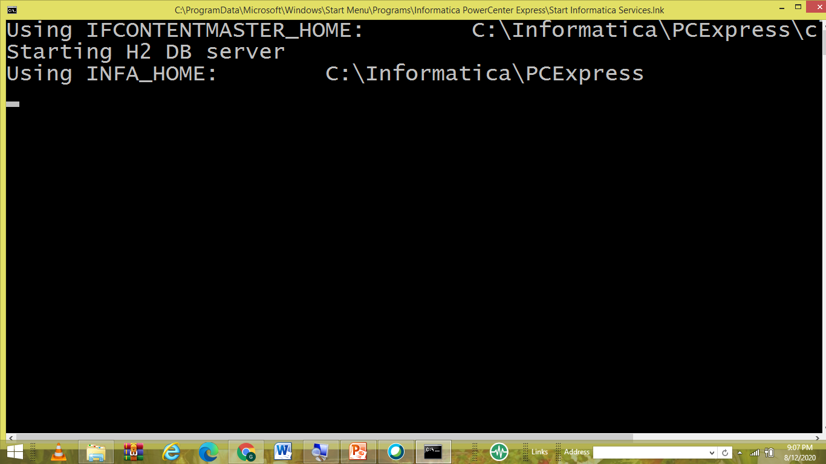

Slide 5


Slide 6
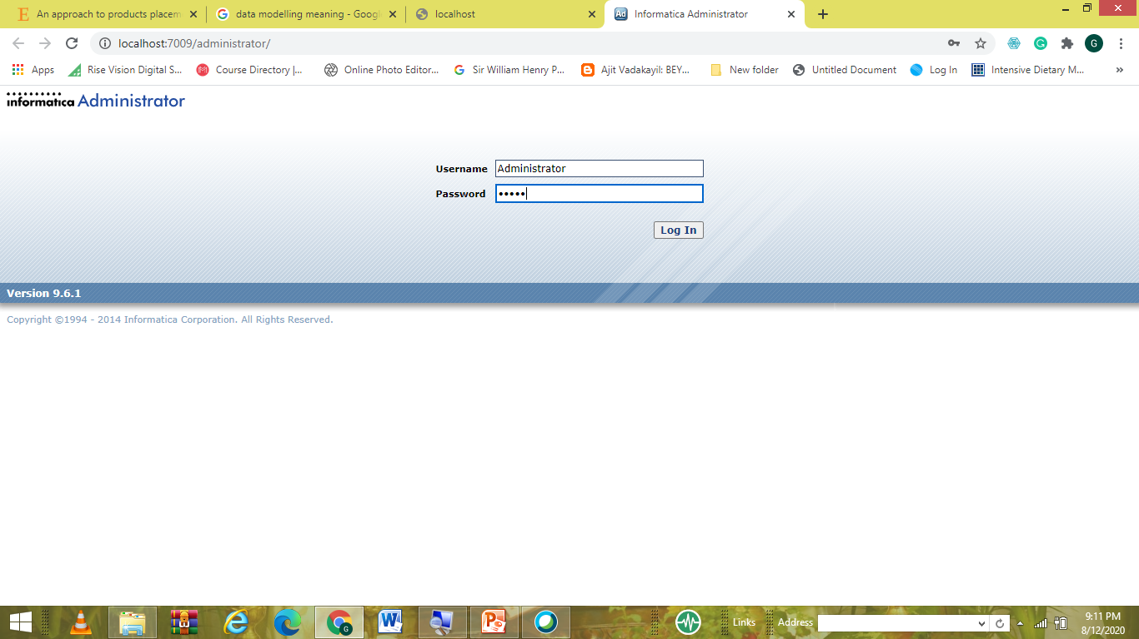

Slide 7
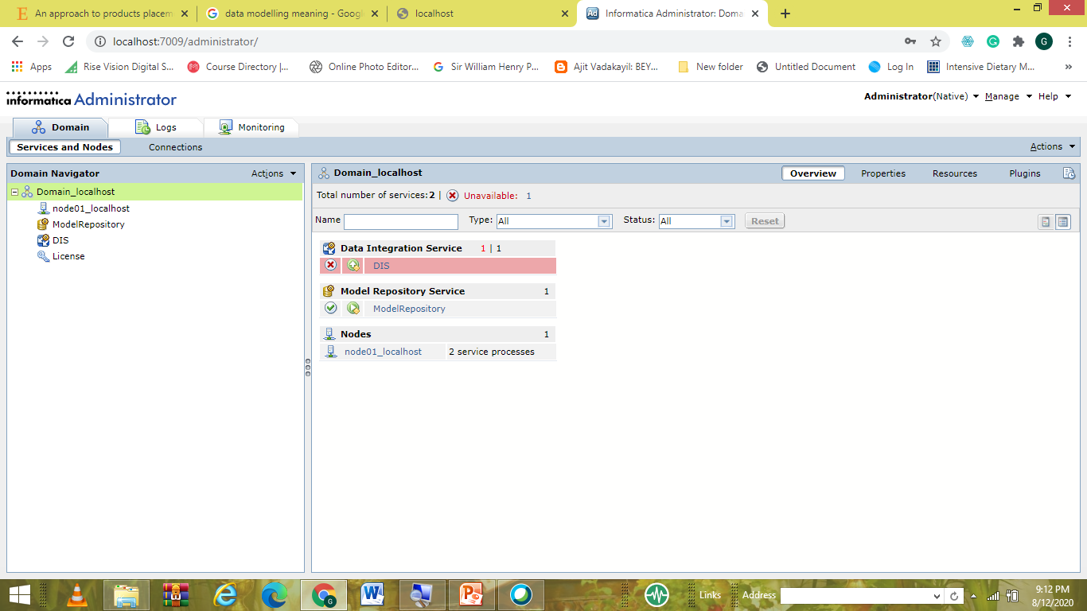

Slide 8
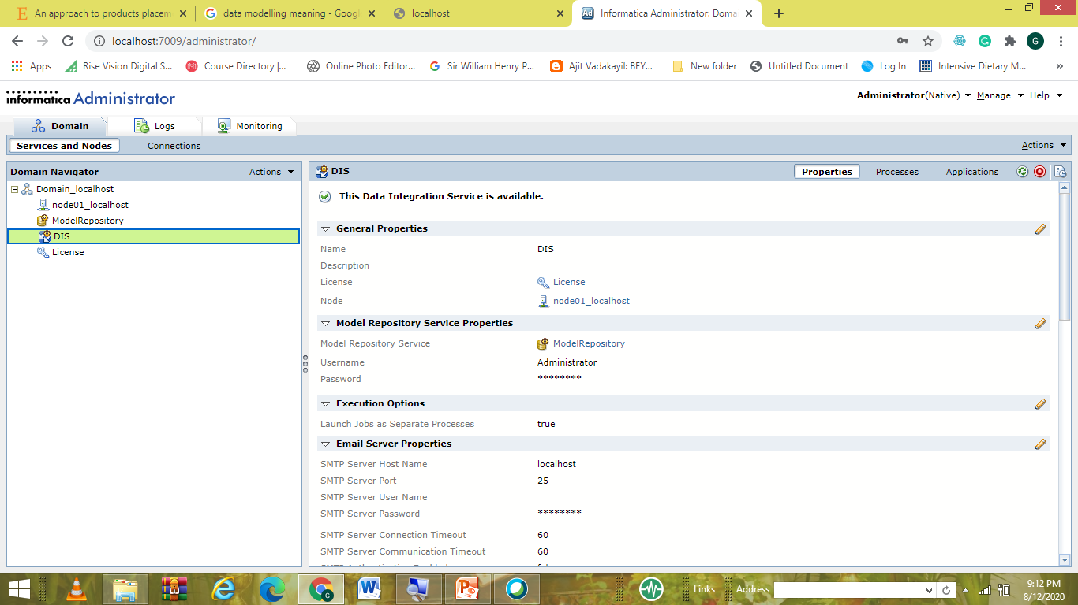

Slide 9


Slide 10
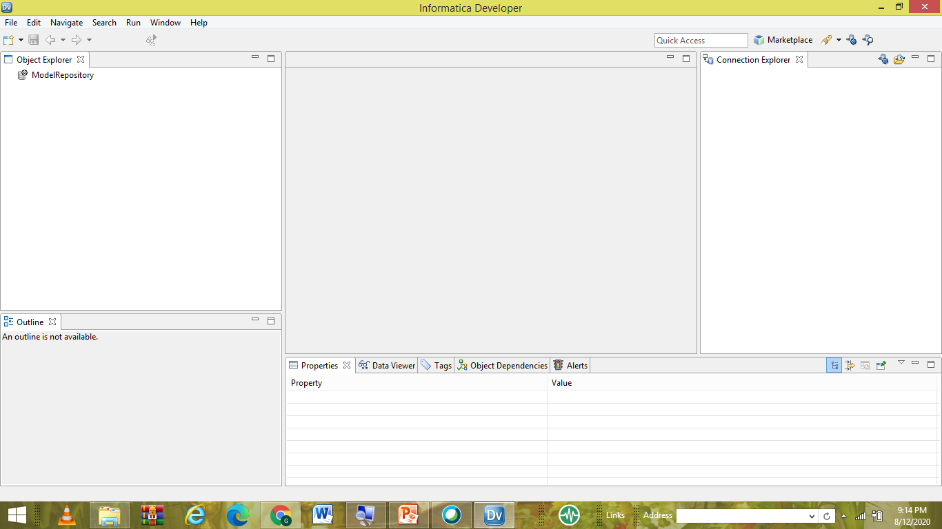

Slide 11
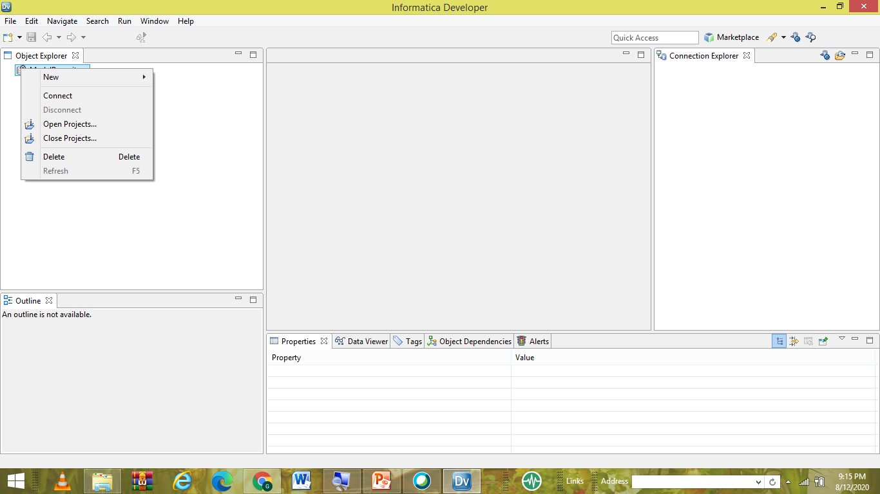

Slide 12
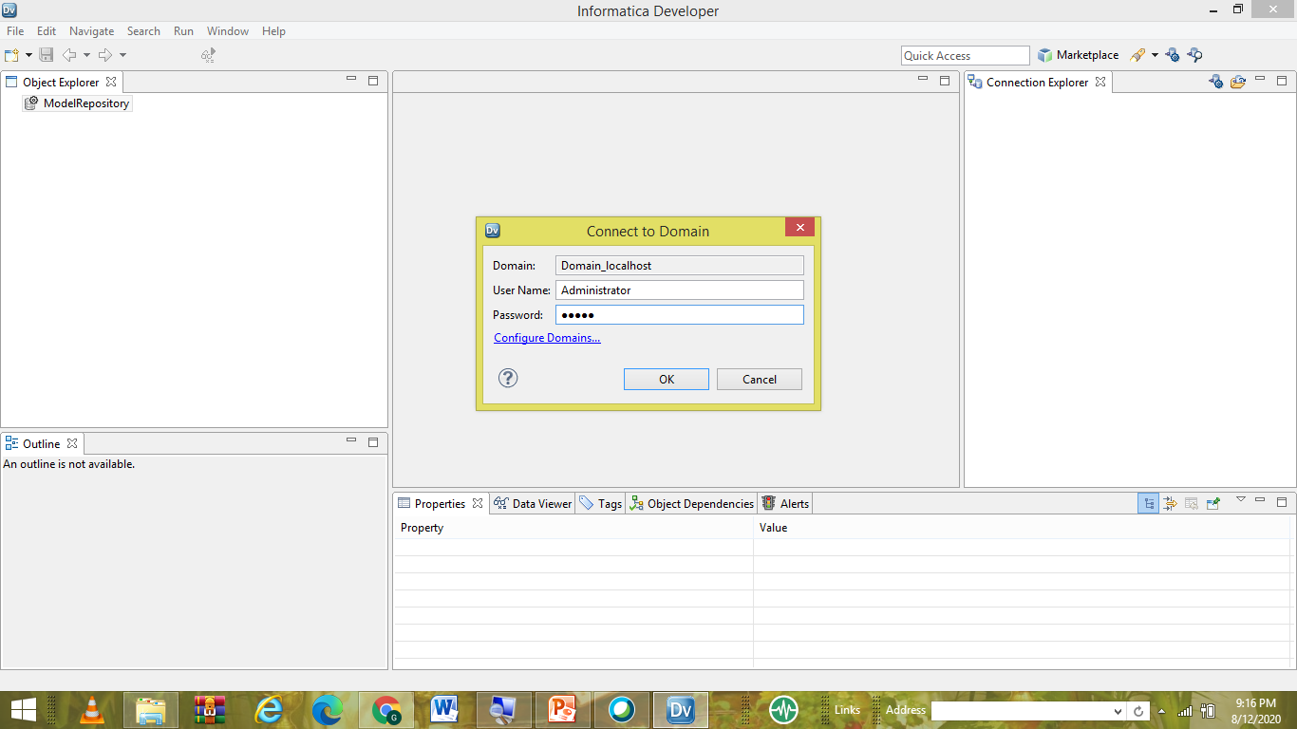

Slide 13
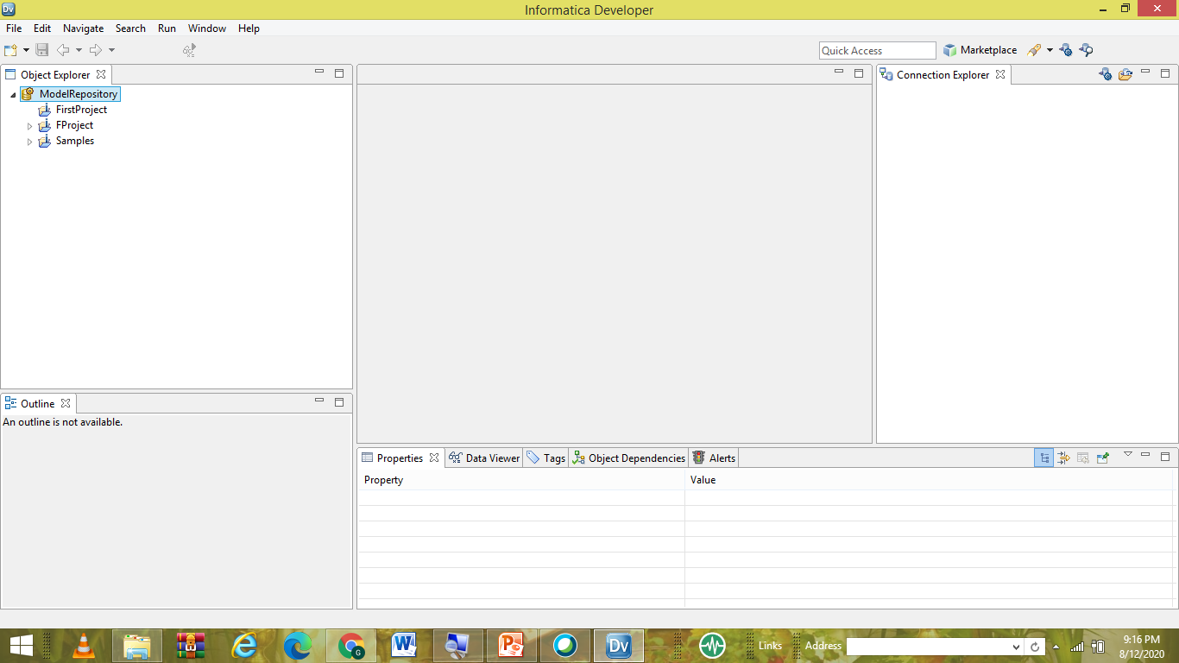

Slide 14
Filter transformation
• Active Transformation • Used to filter the data or reduce the amount of data. • Single condition can be applied at a time. • Filter transformation accepts only two types of data - Boolean (True or False) • Filter accepts condition satisfied data. • The false data is rejected or dropped to the bad files. (Drawback)

Slide 15
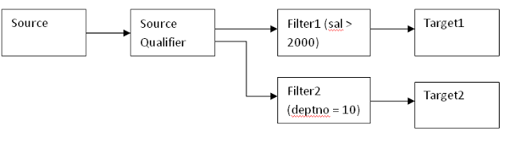
Scenario 1: More than on targets.
We can’t combine multiple conditions in one filter

Slide 16
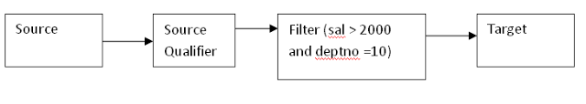
Scenario 2: Only one target.
Here we can combine multiple conditions in one filter using logical operators (AND, OR)

Slide 17
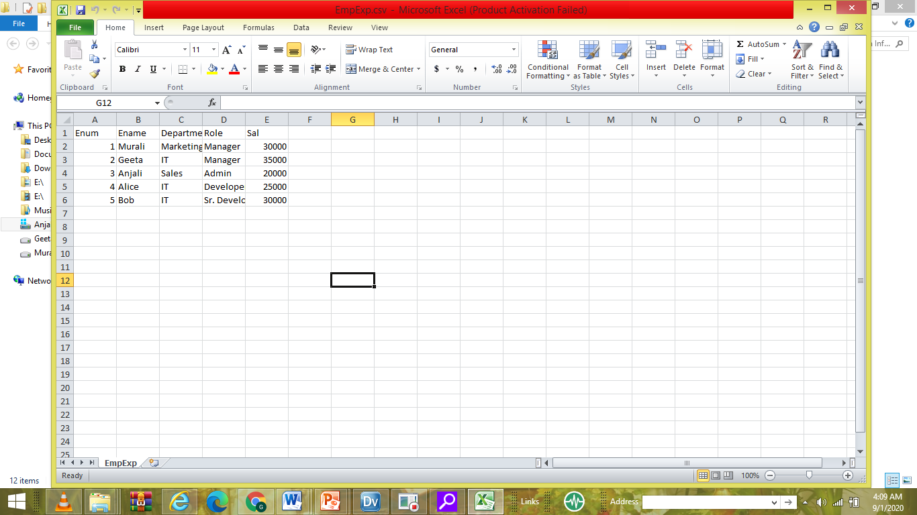

Slide 18
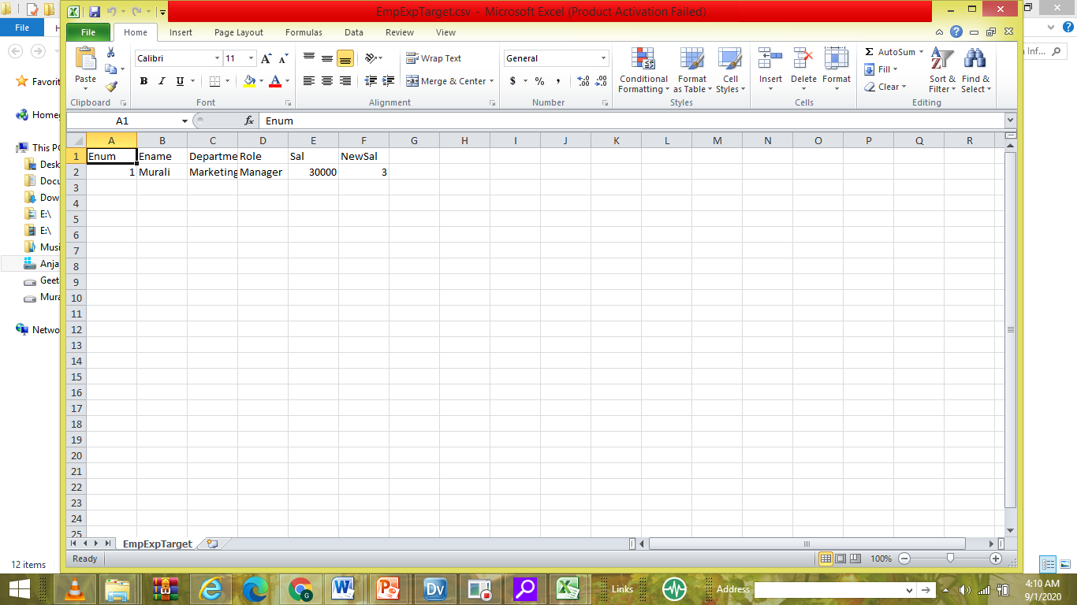

Slide 19
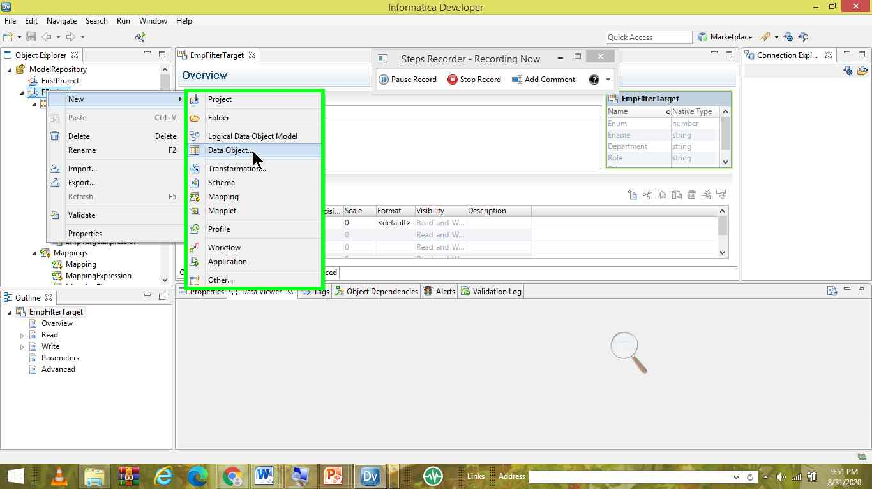

Slide 20
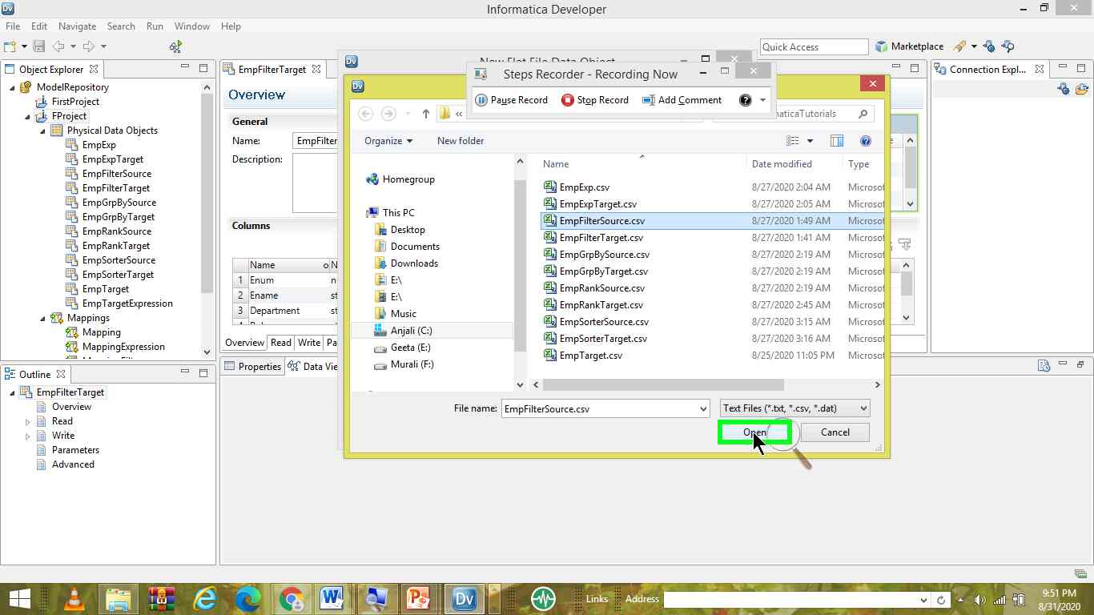

Slide 21
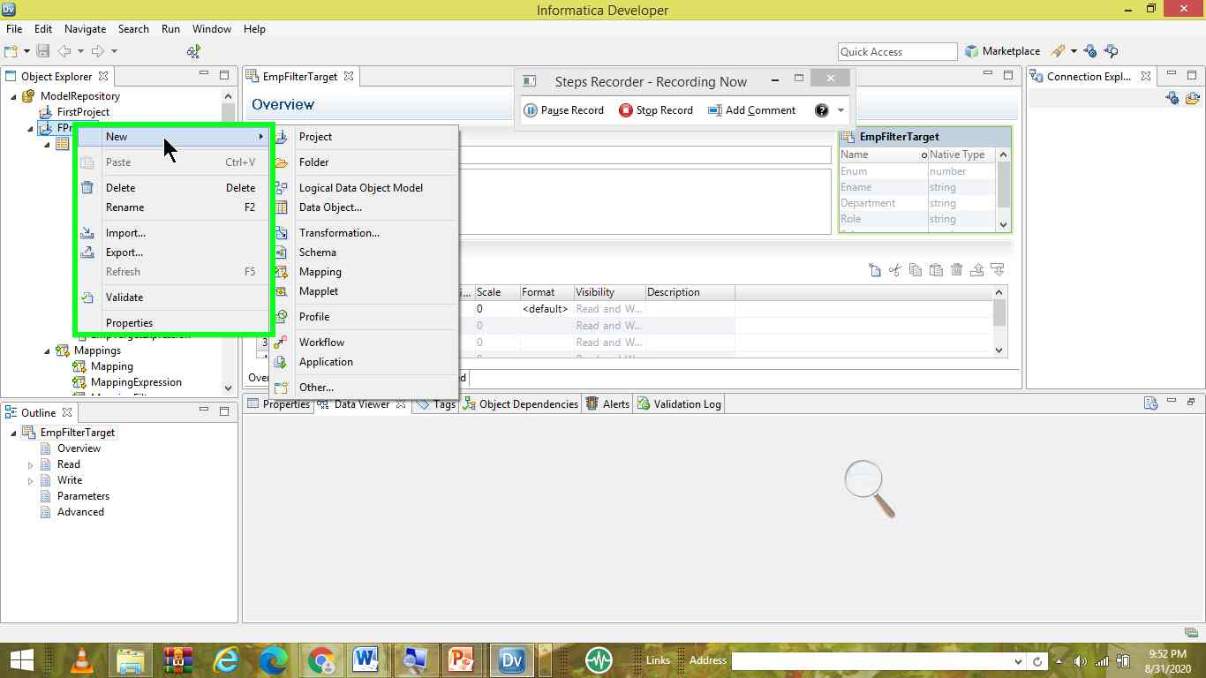

Slide 22


Slide 23


Slide 24
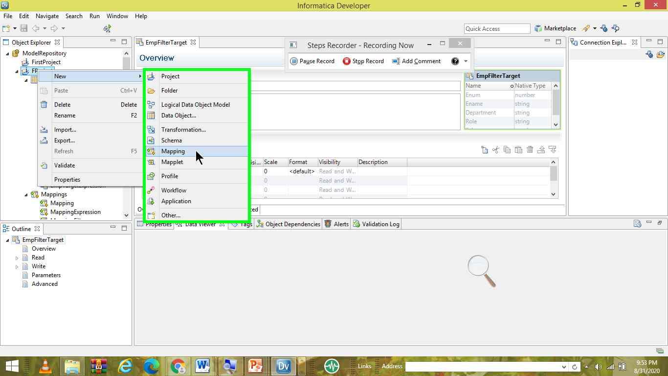

Slide 25
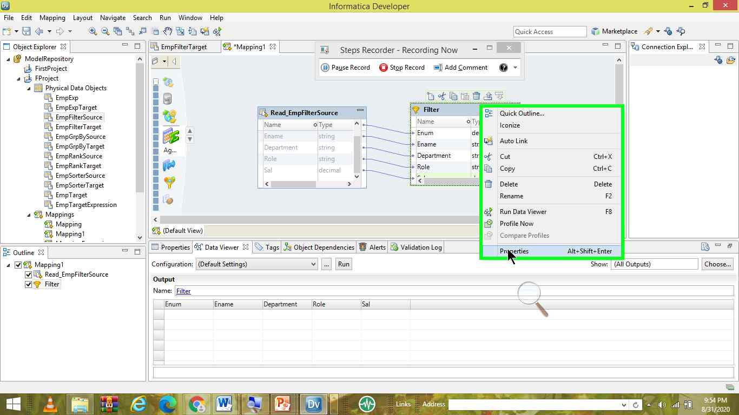

Slide 26
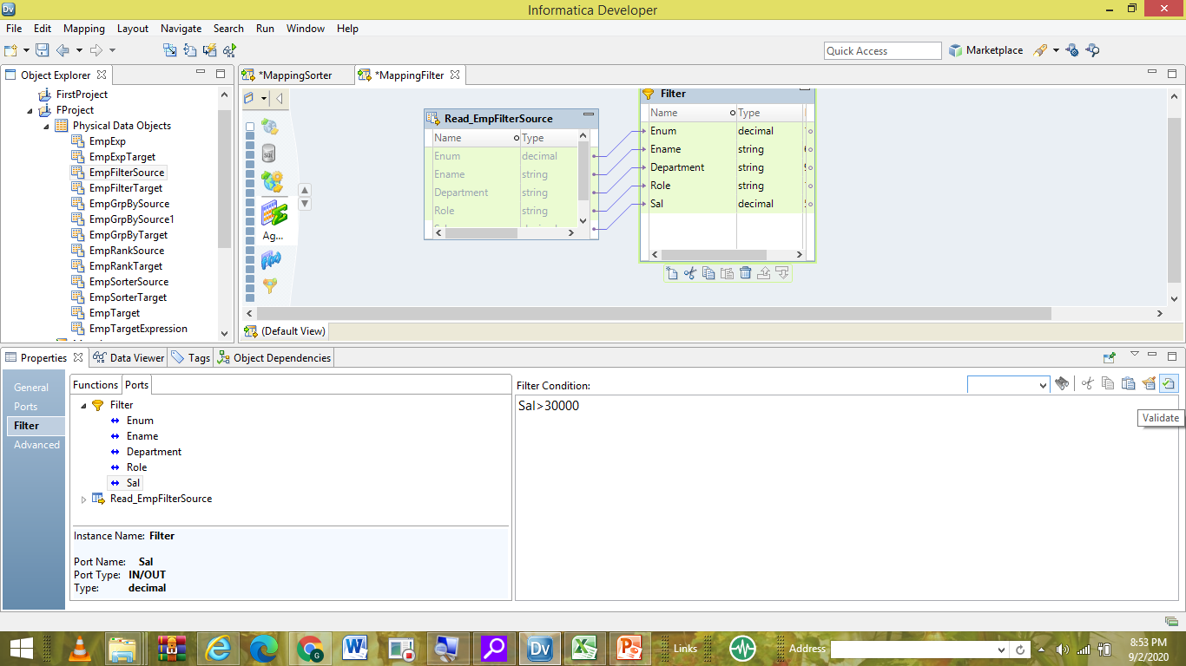

Slide 28
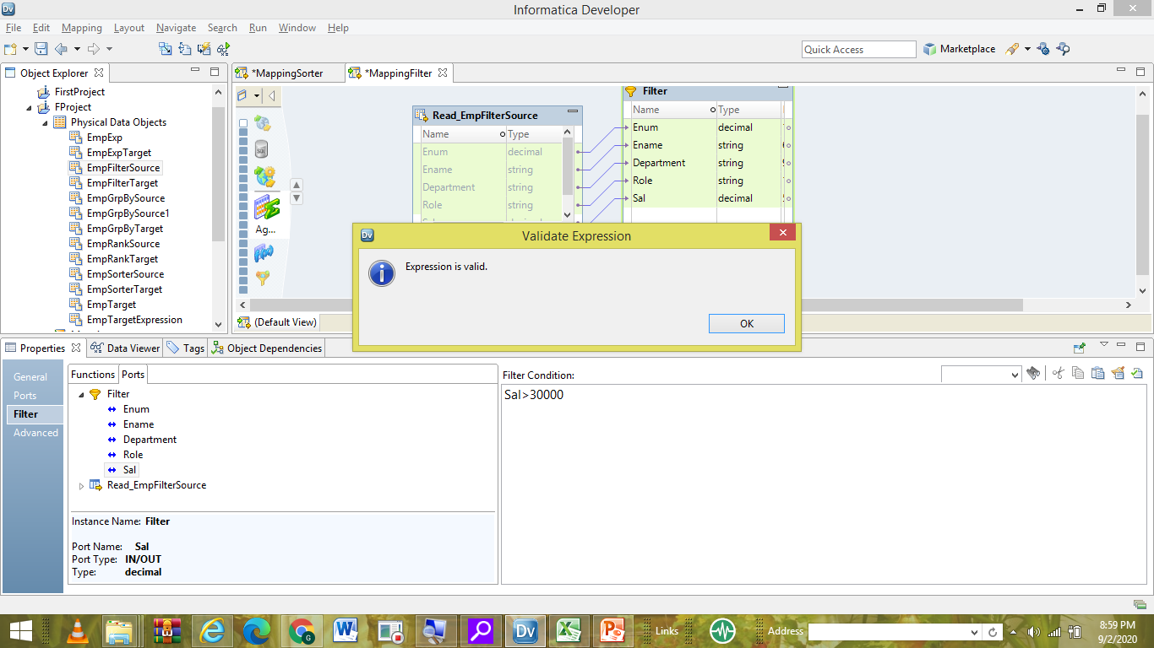

Slide 29
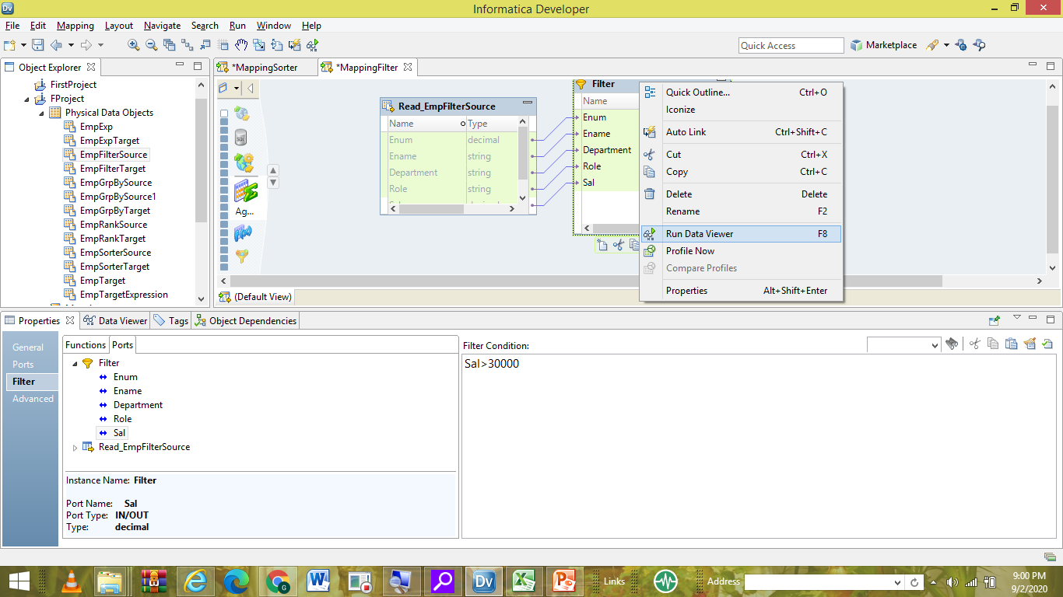

Slide 30
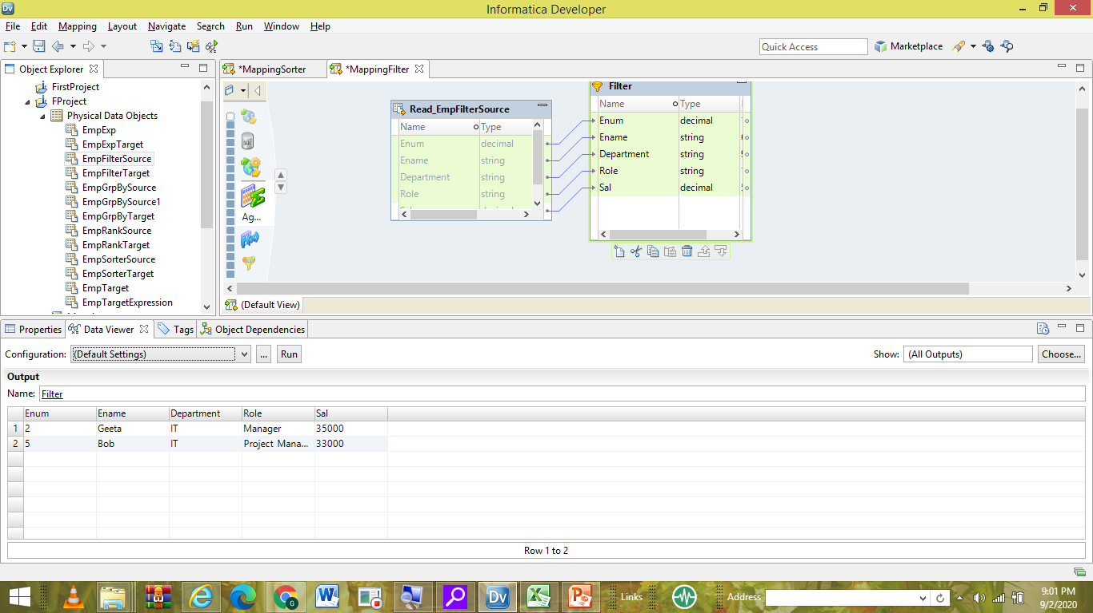

Slide 31
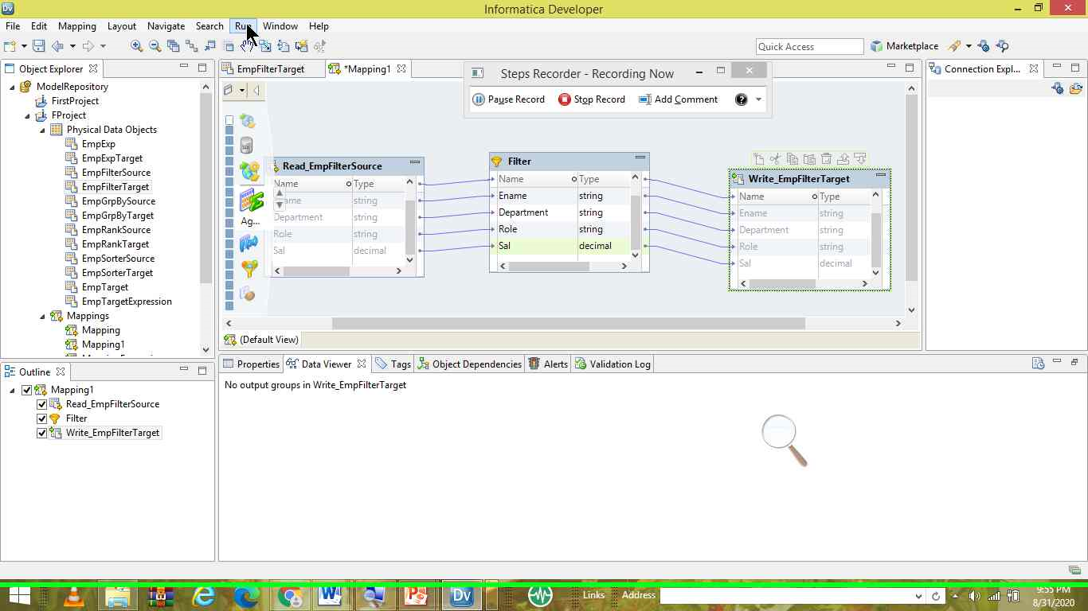

Slide 32
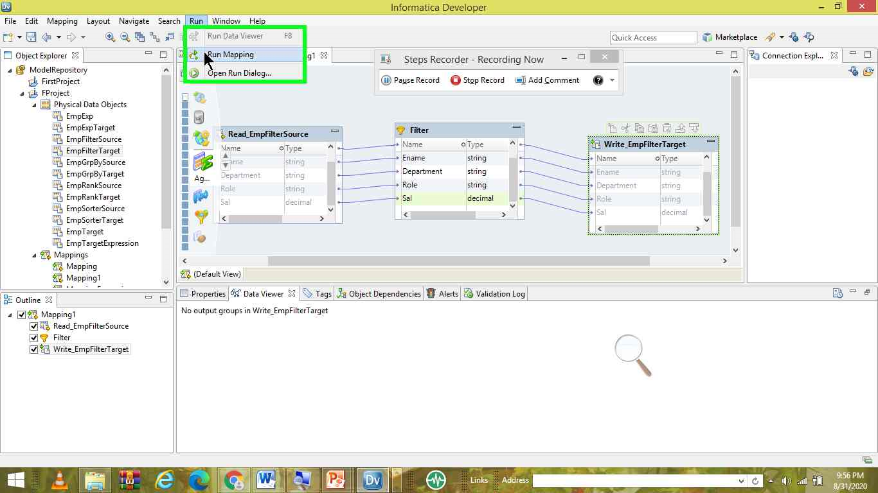

Slide 33
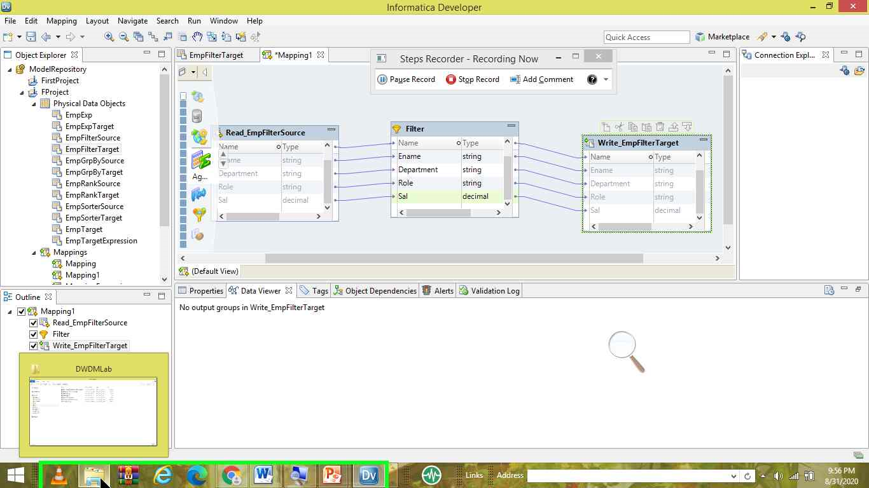

Slide 34
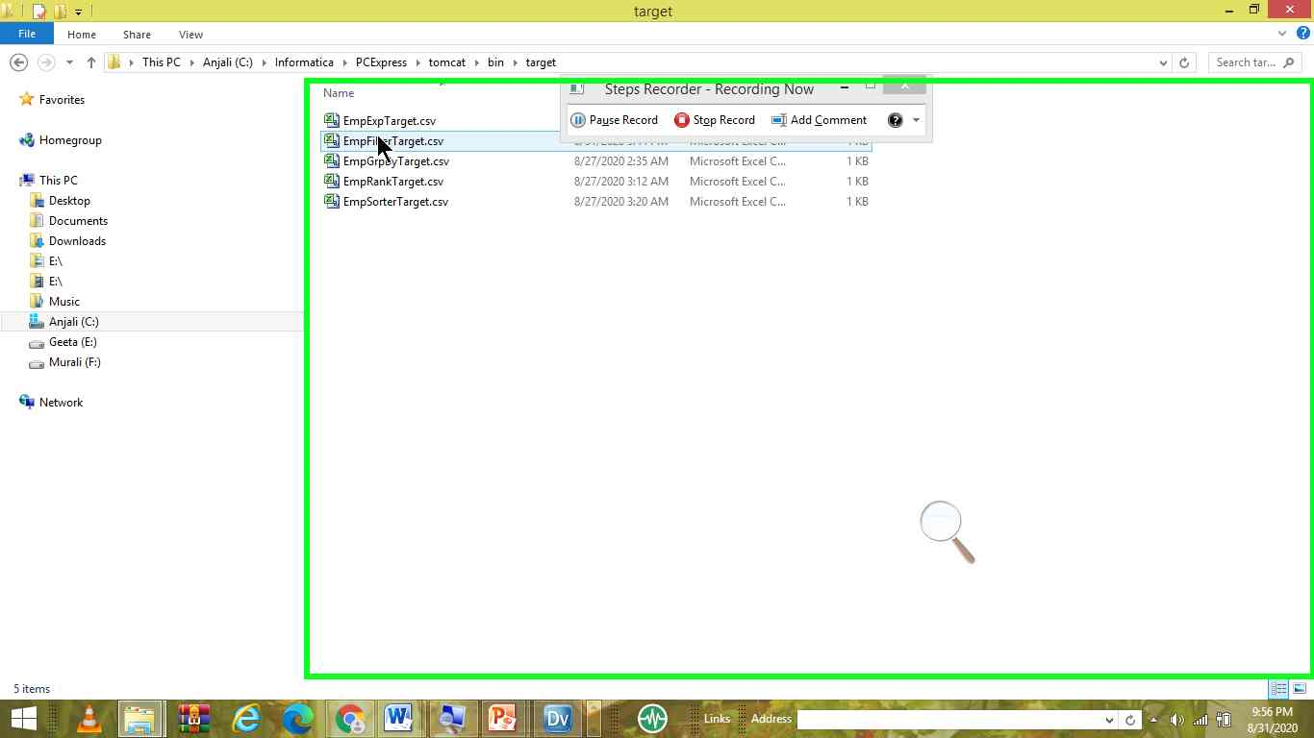

Slide 35
